Slide 1

INTRODUCTION
NAME OF TEAM-JARVIS
NAME OF PROBLEM -VOCATIONAL CARRIER
Problem Statement: Helping Youth make informed
Problem Code: #MSD19
TEAM LEADER NAME - SATYAM MISHRA

Slide 2
ABOUT THE VOCATIONAL CARRIER
A vocational school, sometimes also called a trade school, career center, or vocational college, is a type of educational institution,
In the vocational carrier 80% have practical work and 20% theory.
Vocational education is concerned with the training on vocation. It is related to productivity. Vocational education prepares individuals for jobs. It has adequate employment potentialities. It helps in broadening of horizon.

Slide 3
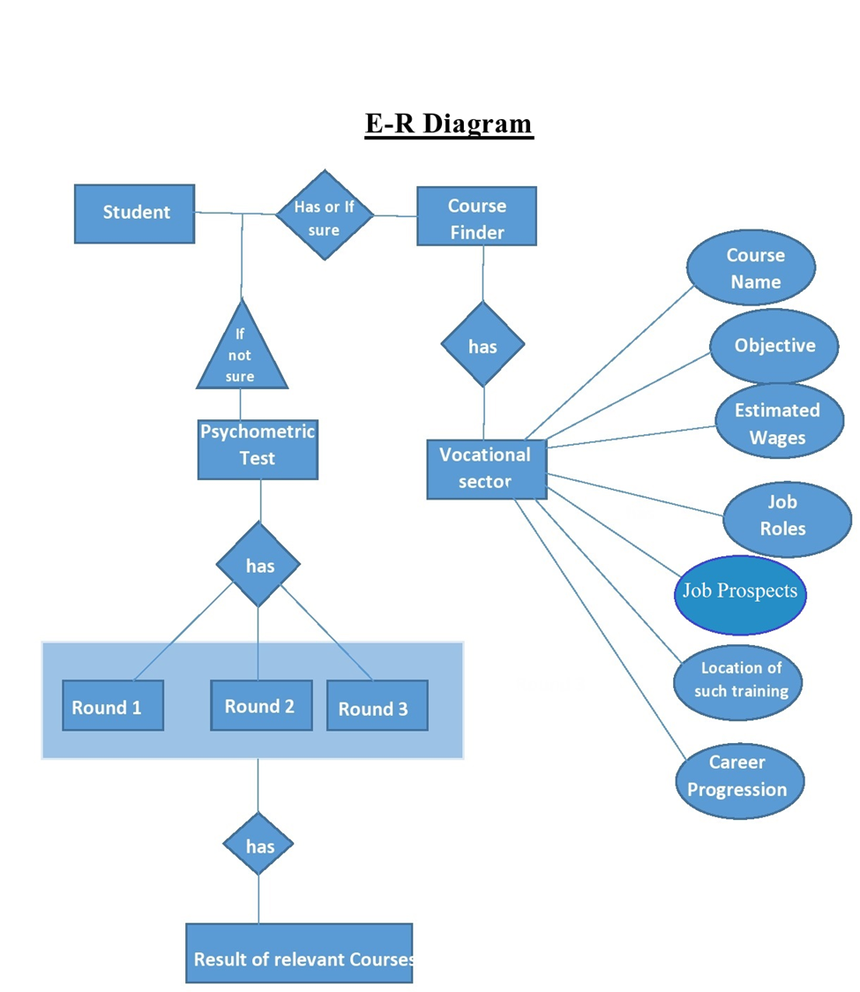
E-R DIAGRAM

Slide 4
Procedure for Psychometric test
After logging in student has to tell his area of interest, then on the basis of his area of interest Psychometric test will cover 3 rounds:-
Round 1: Aptitude & Reasoning Test.
Round 2: Verbal Test.
Round 3: Psycho Analysis.

Slide 5
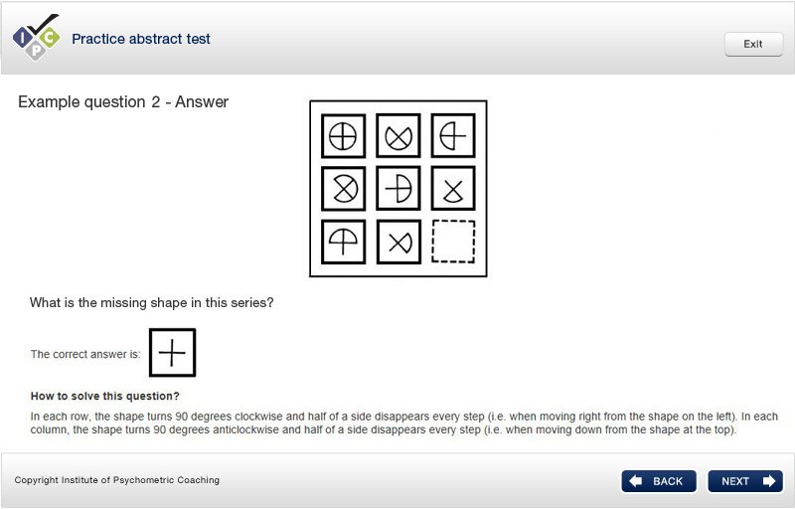
Round 1: Aptitude & Reasoning Test.
Aptitude test is used in assessment of student’s logical reasoning and thinking performance & reasoning test measures how well a student can identify a pattern within a large amount of data.
EXAMPLE -:

Slide 6
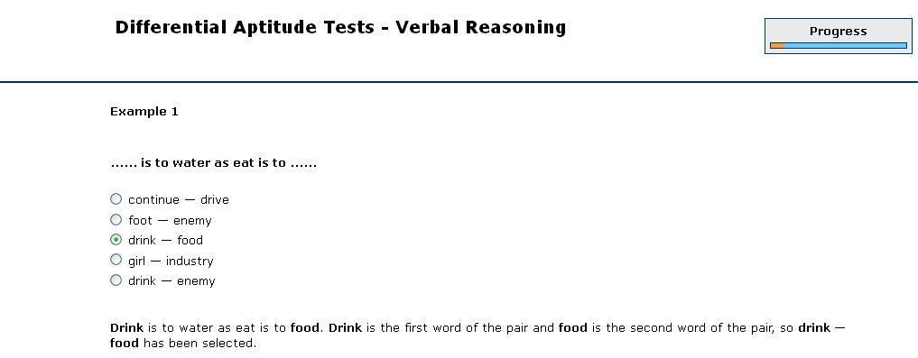
Round 2: Verbal Test.
These tests involve grammar, Verbal analogies. It tests the communication level of a student.
EXAMPLE-:

Slide 7
Round 3: Psycho Analysis
Psycho analysis Test includes personality & mental health test of a student.
After the completion of Psychometric test, result will be declared & on the basis of result student will be notified which field and course suits him & all the details of the course that we have described before. Student can also compare two or more courses & choose accordingly

Slide 8
Technology Stack
HTML , CSS, Bootstrap
JAVASCRIPT
AJAX
MYSQL
PHP
SQL INJECTION(Security)

Slide 9
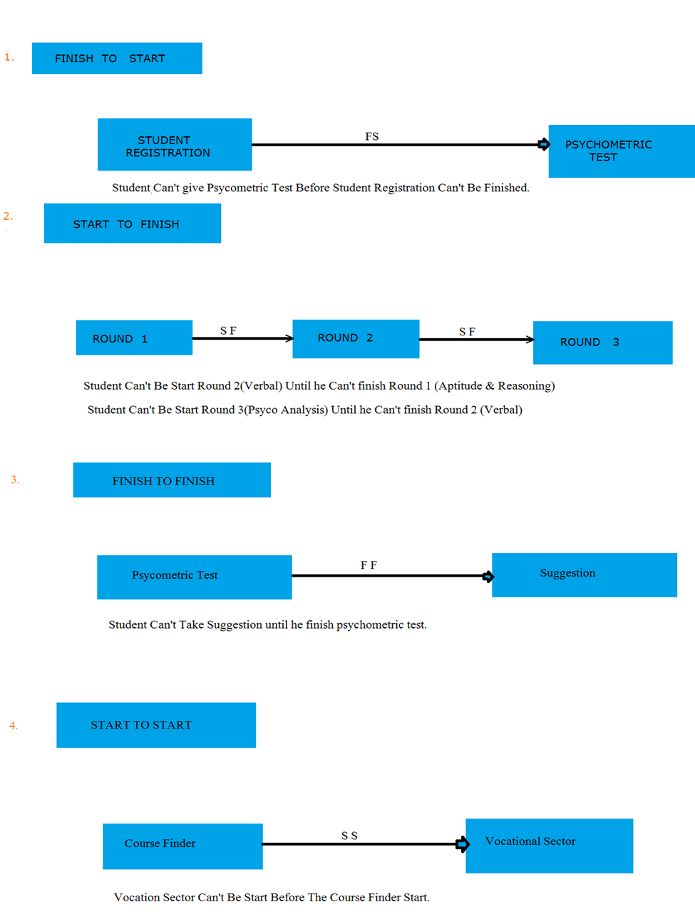
Dependencies

Slide 10
SOLUTION
Two roads diverged in a career, and students choose the one more traveled by. Unfortunately, when choosing a career, most students aren't exposed to "the road less traveled" and are forced to choose the only one they know. Naturally people make decisions based on options that have become familiar to them
To give special focus on the skill training development of students, As a part of solution we are developing a website which will help the youth Students of India to choose their career in vocational sector on the basis their interest and skills this will help in increasing participation of students in skill training.

